Slide 1

July Lodge Chiefs Call
Monday, July 7th, 2025
7pm ET
Google Meet
Section E5
Order of the Arrow, Scouting America

Slide 2

Roll Call

Slide 3
Section Officer Reports

Slide 4

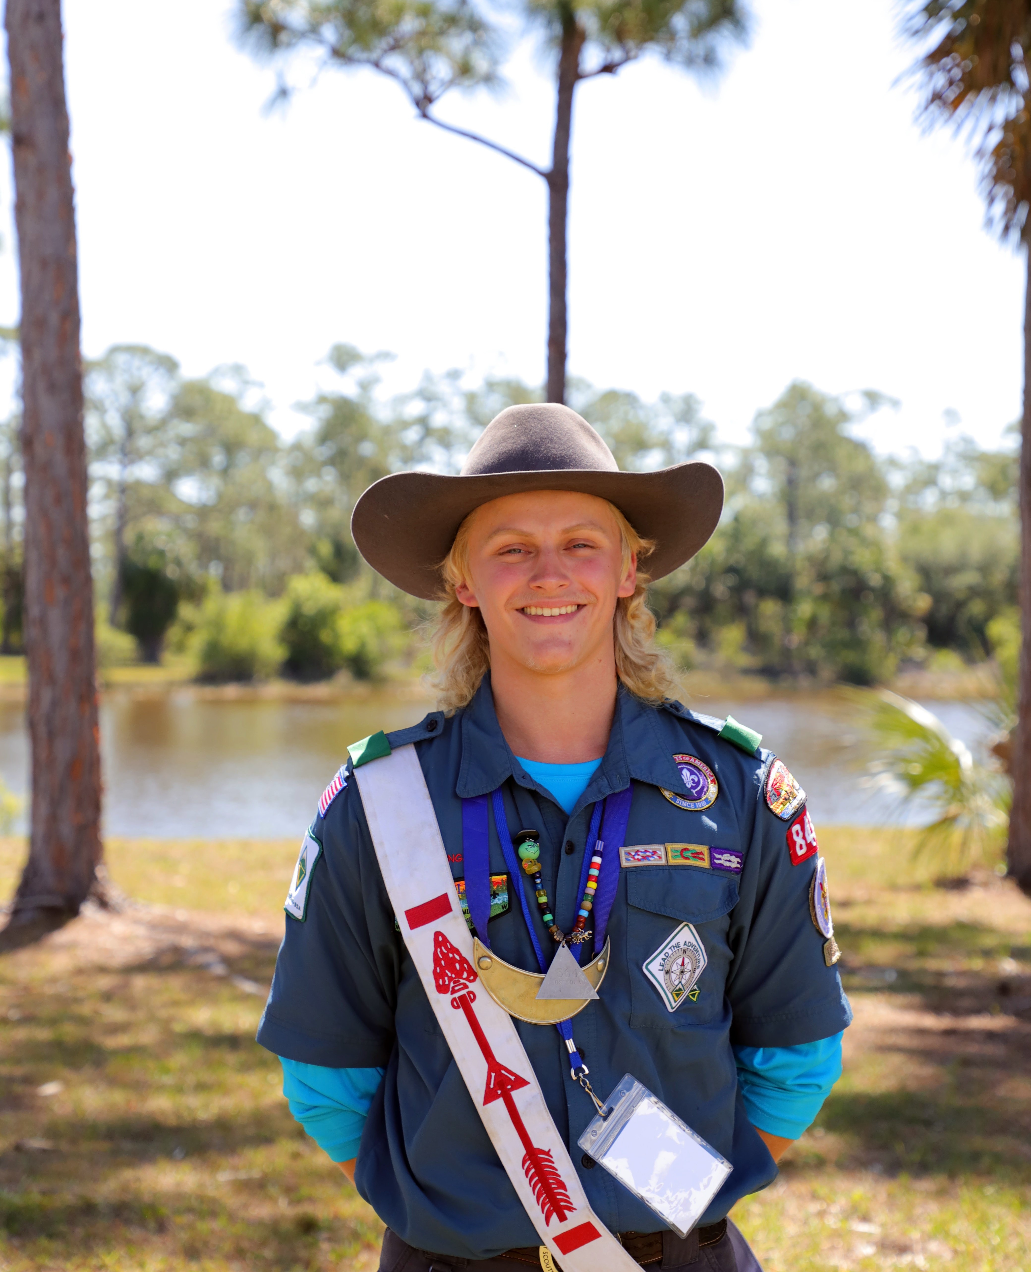
Section Chief’s Report
Nick Switzer

Slide 5
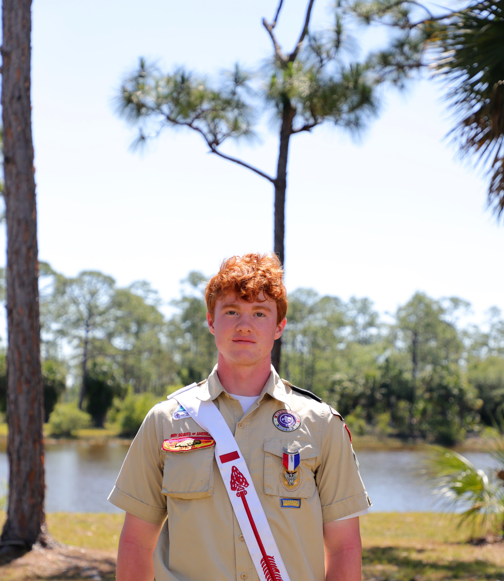
Section Vice Chief’s Report
Walter Mentz

Slide 6
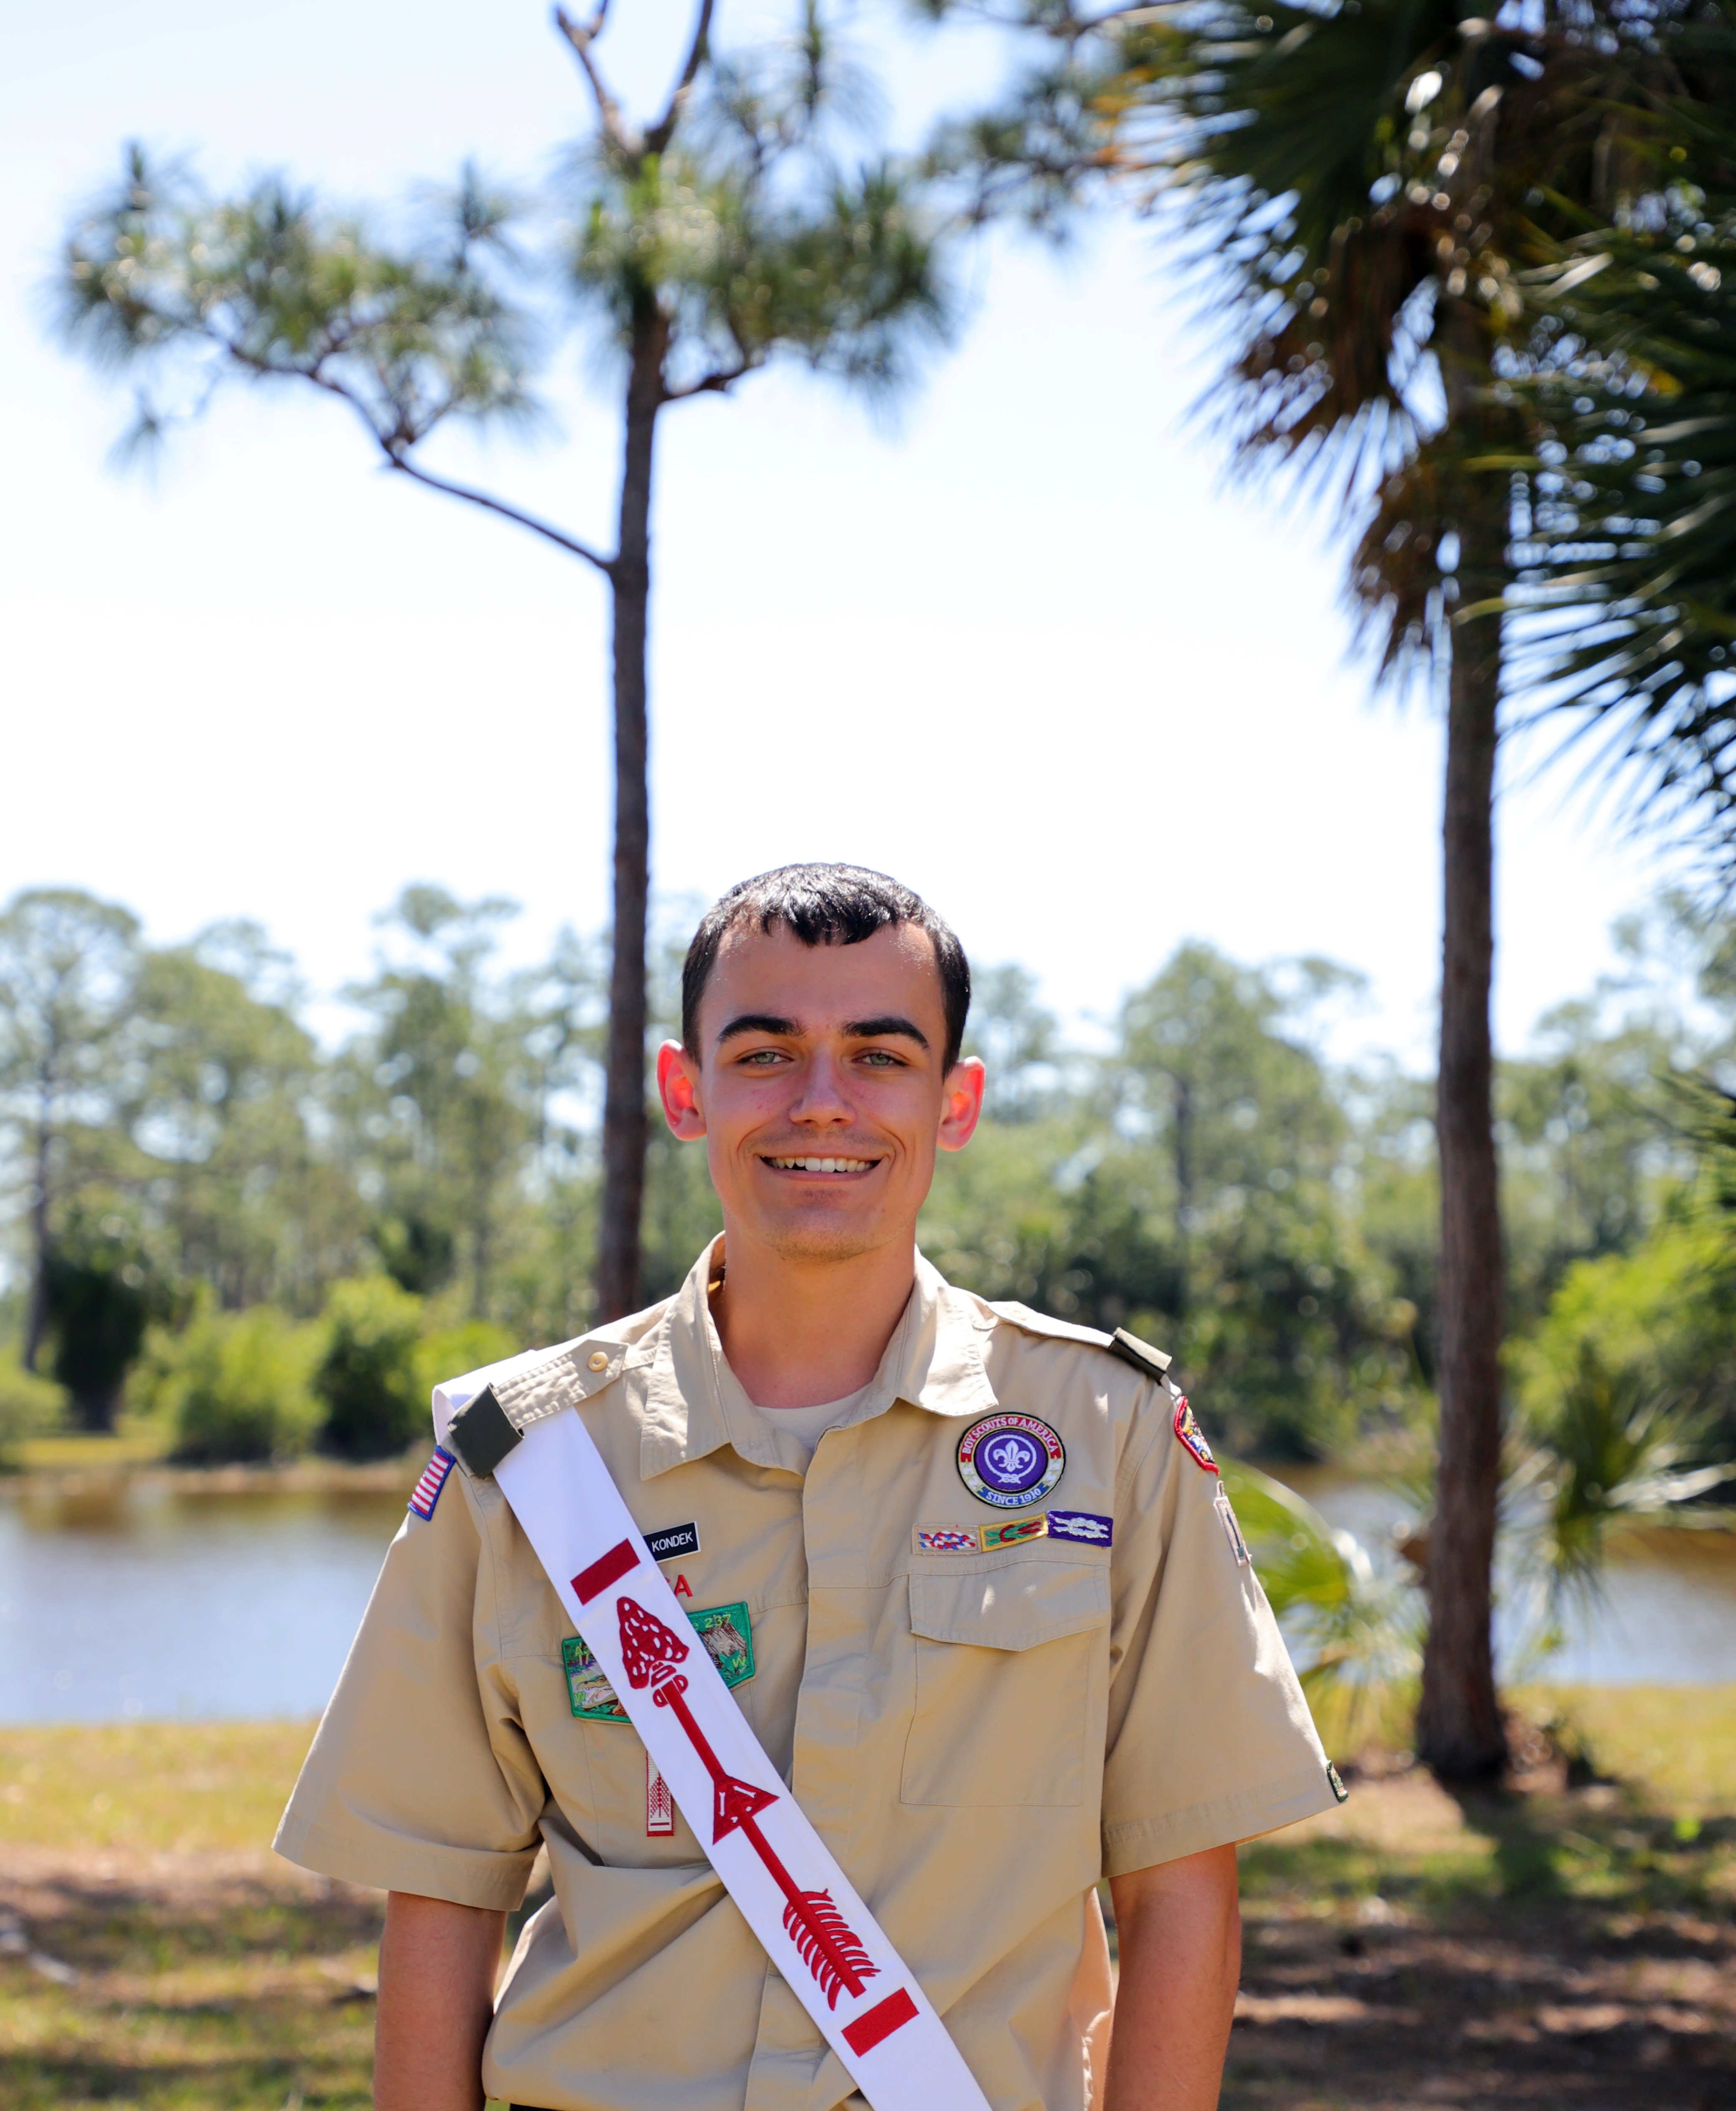
Section Secretary’s Report
Brady Kondek

Slide 7
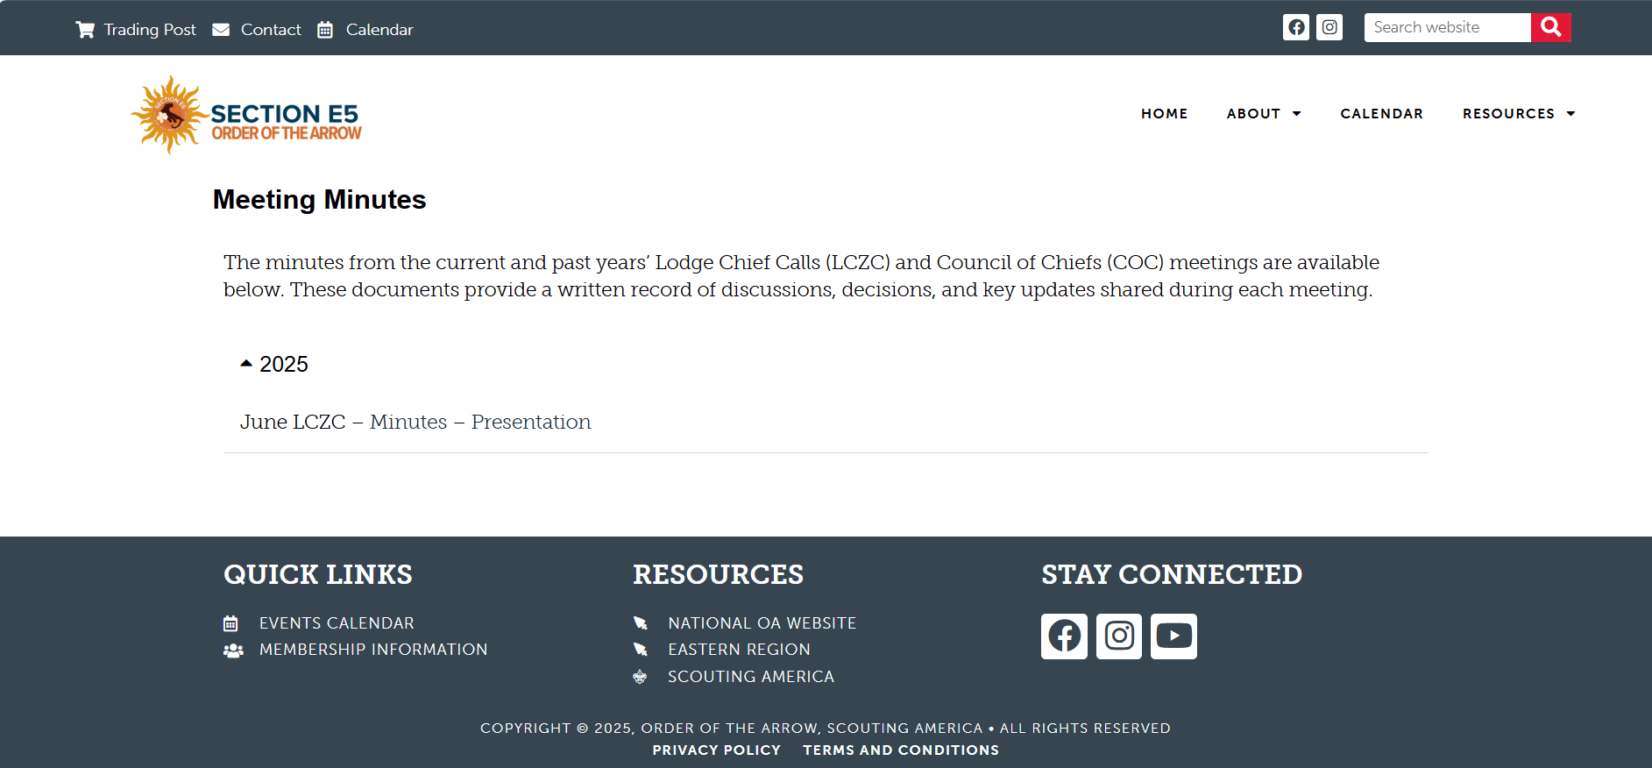
Meeting Minutes Disbursement
Meeting minutes will not be sent out via email, instead posted on the Section Website following each meeting (about a day after).
All meeting minutes and accompanying slide decks will be posted under Resources > Meeting Minutes.

Slide 8
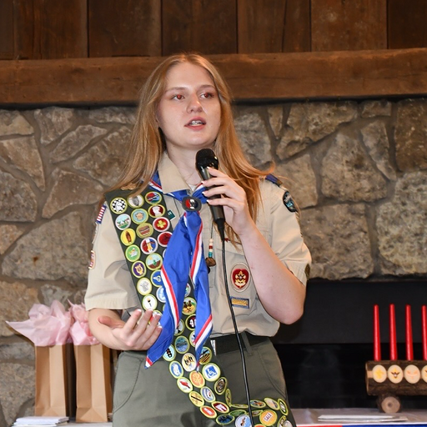
New Communications Chair
Current Uh-To-Yeh-Hut-Tee Lodge Secretary
Previous Section E2 Secretary
National Content Deputy Lead for the OA’s National Communications Committee (NCC)
Kaylee DeLory

Slide 9
Section Communications Committee
Will manage all aspects of the section’s communication, responsible for the content creation, publications, branding, and promotions from the section level, including our website and social media.
The mission of the committee focuses on supporting the communication needs of the section and member lodges, while also conveying the message of the section and the OA to all Arrowmen.
The goal is to generate excitement and engagement at the section level, encouraging Arrowmen to get involved and actively participate, ensuring the section is vibrant and visible, while always putting lodges at the center of what we do.

Slide 10
EASTERN REGION SECTION 5
Communications Committee Organizational Chart
Communications Leadership
Brady Kondek
Section Secretary
Tim Faughnan
Section Assoc. Adviser
Kaylee DeLory
Communications Chair
Web Team
Social Media Team
To Be Filled
Web Lead
To Be Filled
Social Media Lead
X
Web Team Member
X
Web Team Member
X
Social Media Team Member
X
Social Media Team Member
X
Web Team Member
X
Web Team Member
X
Social Media Team Member
X
Social Media Team Member
X
Web Team Member
X
Web Team Member
X
Social Media Team Member
X
Social Media Team Member

Slide 11
Lodge Chief Reports

Slide 12


Aal-Pa-Tah Lodge 237

Slide 13

Echockotee Lodge 200

Slide 14

Osceola
Lodge 564

Slide 15

O-Shot-Caw Lodge 265

Slide 16

Semialachee Lodge 239

Slide 17

Tipisa
Lodge 326

Slide 18

Uh-To-Yeh-Hut-Tee
Lodge 89

Slide 19
Upcoming Events

Slide 20

2025 Section Leadership Summit
November 14th – 16th, 2025
Camp Shands, Echockotee Lodge

Slide 21
New Business

Slide 22


Slide 23
Section Merchandise

Slide 24
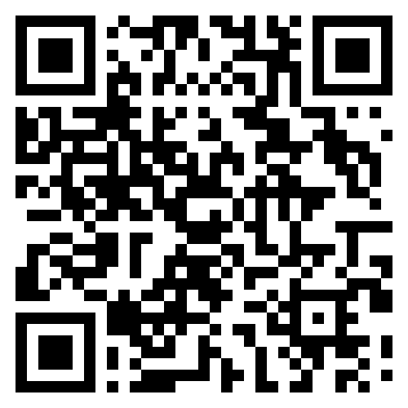
Section Merchandise
Merchandise Ideas: We are seeking your input on potential section merchandise, including options like shirts, hats, patches, and more.
Year-Round Trading Post: We are in the works of planning to establish an online trading post where Arrowmen can order merchandise year-round, also offering shipping options.
Building Section Spirit: Our overall goal is to create items that foster a sense of community and pride within our section and establish a better identity.
Submit Your Ideas!

Slide 25
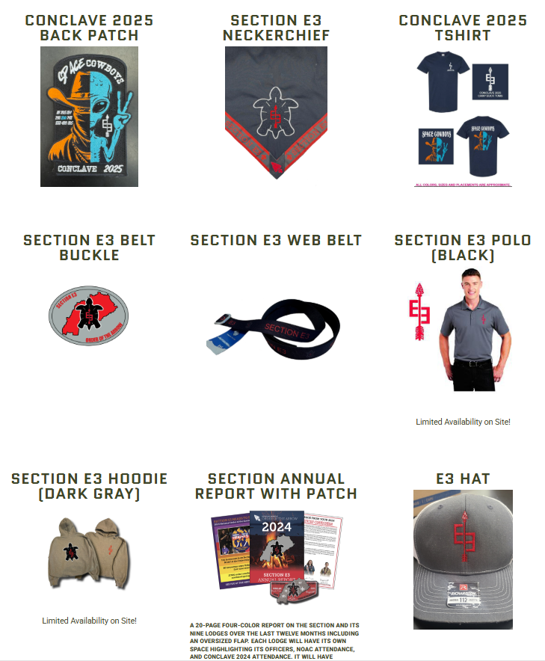
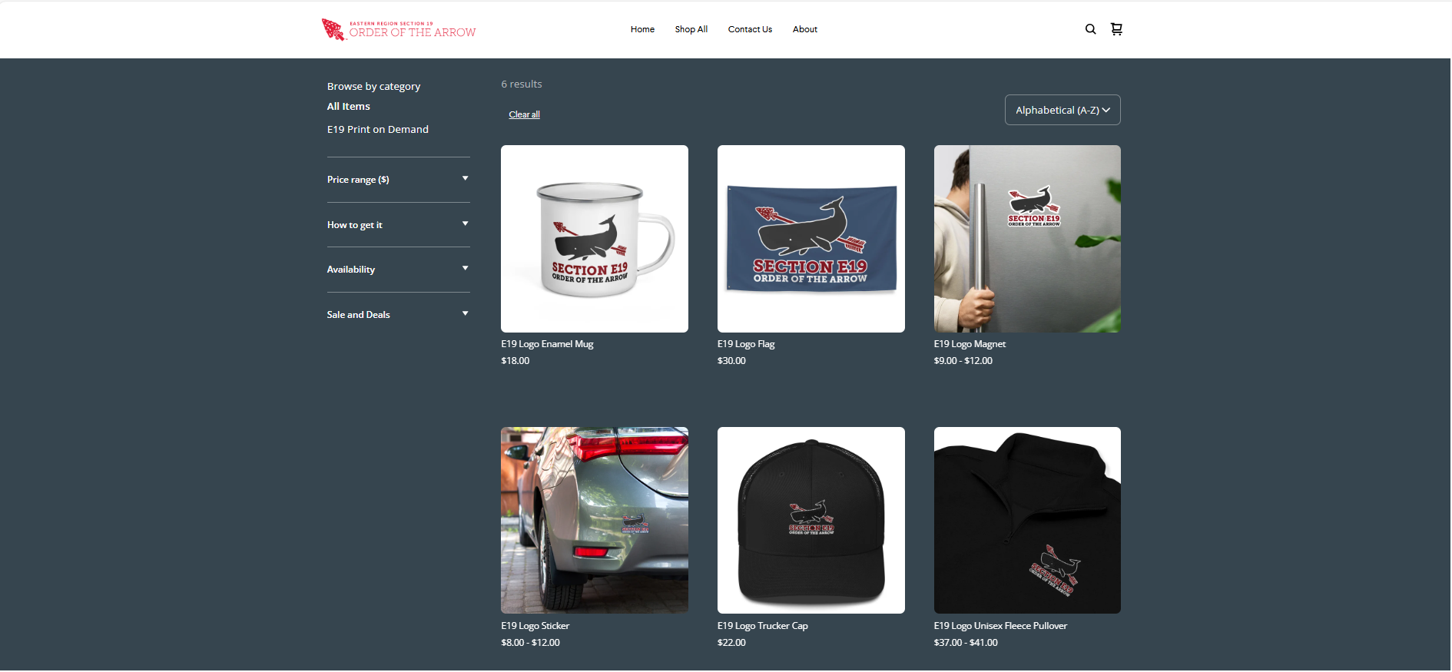
Examples of Section Trading Posts

Slide 26
Section Service Project

Slide 27
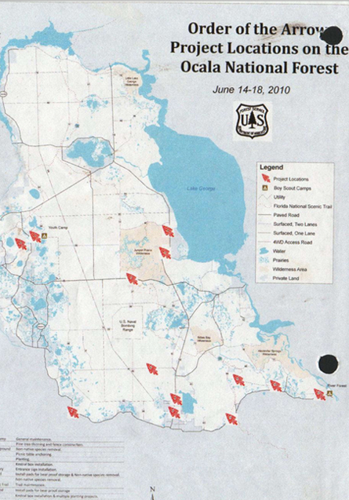
History of Section S-4 FourCorps 2010
Overview: FourCorps 2010 took place from June 13th-19th, 2010, in the Ocala National Forest, involving members of Section S-4 and OA members from outside Florida (including the current national chief at the time), in collaboration with the United States Forest Service for land management and conservation projects.
Project Highlights: Key projects included constructing 80 kestrel nesting boxes, pouring 82 concrete pads for bear-proof storage boxes, and installing picnic tables at various campgrounds. A significant campfire ring was also built, featuring a 5ft wide x 25ft long sidewalk leading into a 20ft diameter concrete ring with a brick inlay and a painted compass rose, along with the planting of two Centennial live oaks to commemorate the 100th anniversary of the Boy Scouts of America.
Impact: The initiative resulted in 4500 hours of volunteer service and approximately $6,000 worth of materials donated to support the projects.

Slide 28
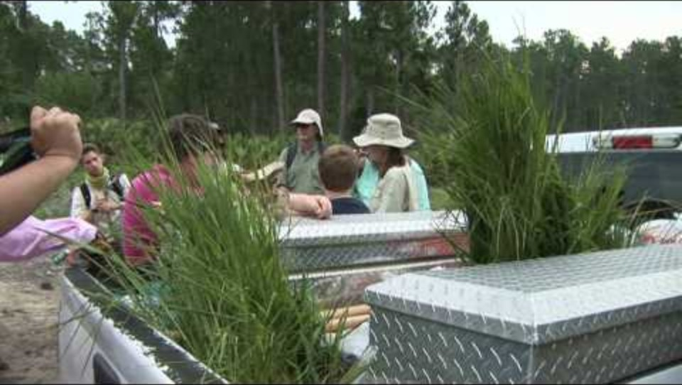
History of Section S-4 FourCorps 2010

Slide 29
Section Service Project
We are excited to propose a new section-wide service project, building on past initiatives, but with a new name. This project aims to engage members across our section in impactful service while promoting community involvement and environmental awareness. We welcome your ideas and input as we develop this initiative together!

Slide 30
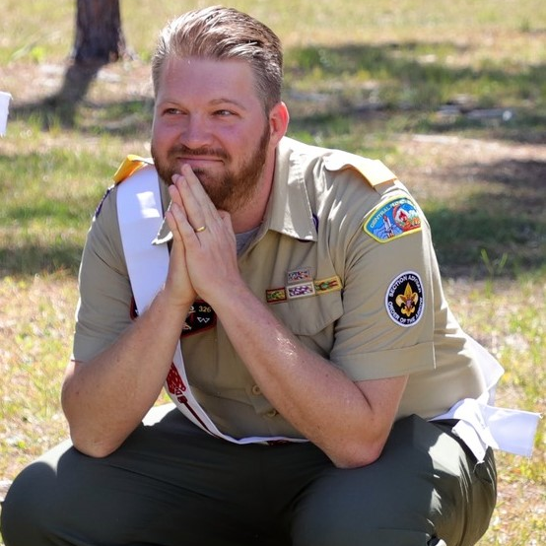
Section Adviser’s Minute
Michael Todd

Slide 31
Meeting Adjourned
Thank you!

